Slide 1
Machines
Their influence on us

Slide 2
Why are the keys on a QWERTY typewriter laid out the way they are?

Slide 3
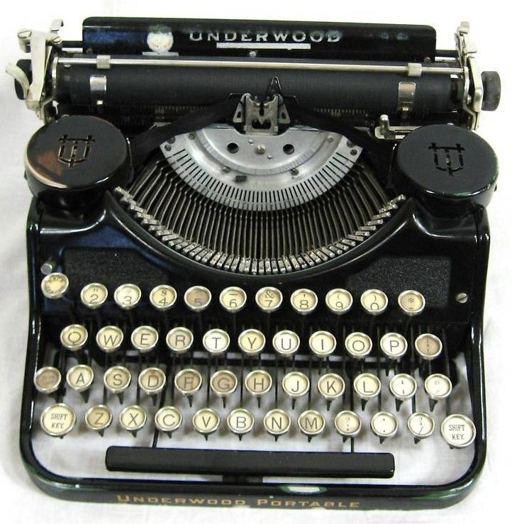

Slide 4


Slide 5
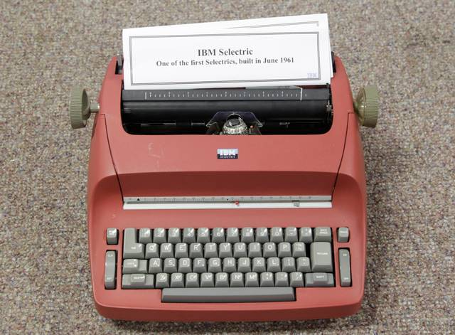

Slide 6
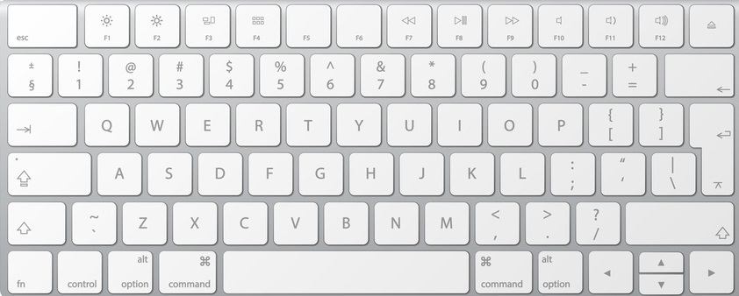

Slide 7
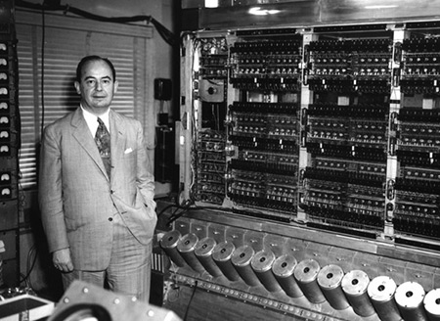
The Von Neumann Machine
fundamental abstraction = the register

Slide 8
Von Neumann isomorphism
Conventional programming languages are basically high level, complex versions of the von Neumann computer. Our thirty year old belief that there is only one kind of computer is the basis of our belief that there is only one kind of programming language, the conventional—von Neumann--language.
John Backus
1978 Turing Award Lecture

Slide 9
The assignment statement is the von Neumann bottleneck of programming languages and keeps us thinking in word-at-a-time terms in much the same way the computer's bottleneck does.
John Backus
1978 Turing Award Lecture

Slide 10

Uncontrolled jumps - The goto statement

Slide 11
Moore’s law
Single core processors, multicore processors and functional languages

Slide 12
Moore’s law
Moore's law refers to an observation made by Intel co-founder Gordon Moore in 1965. He noticed that the number of transistors per square inch on integrated circuits had doubled every year since their invention. Moore's law predicts that this trend will continue into the foreseeable future.
Source: http://www.investopedia.com/terms/m/mooreslaw.asp

Slide 13

“The industry saw signs that Moore’s Law was running out of steam as far back as 2005, when researchers began to worry that computer processors were becoming so hot that they would soon match the surface of the sun in heat output.
But the industry managed to fix the problem by worrying less about increasing speed and instead splitting tasks among many processors. In effect, it kept things cool by finding a way to share the load.”
Moore’s Law Running Out of Room, Tech Looks for a Successor
By John Markoff, May 2016
NYTimes

Slide 14
In Practice
Multi-core and many-core technologies are on the rise.
The New Moore’s Law
Two Models of Concurrency
Shared state
Message passing

Slide 15
Shared State Concurrency
Mutable State
Mutex or synchronized method needed to lock a specific region in memory
Threats:
Deadlock and starvation
What happens when a program in possession of a lock crashes?
Suited to “Von Neumann isomorphic” models of computation
Java, C++

Slide 16
Message Passing Concurrency
Immutable State (stateless)
Well-suited to computational models underlying functional programming languages
“Your Erlang program should just run N times faster on an N-core processor.”
– Joe Armstrong

Slide 17
Java 8
Lambda expressions and method references
Can be passed as parameters to other methods
Essential to multi-core programming
Applications involving bulk-data on multi-core environments
Enable Collection APIs to control the parallelization of iterations over the data it stores.

Slide 18
The End

